Slide 1
Welcome to my overview of the 3D football game
Presented by Moses Ndale

Slide 2

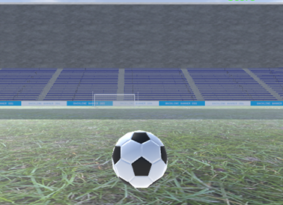
End of year project about a football game, The Norwood School (September 2020 – June 2021)
Outline: I have created a 3D football game project using the unity video game engine that features a single football player in first person to kick a football and score a goal when I was in year 13 studying at the Norwood school sixth form with other students in the same classroom using the computer with the support of the teacher.
Key responsibilities
•To download unity on the computer to start working on my end of year project at the Norwood school.
•To use the unity store to purchase assets, animations, and visual effects for free or a small price to use for the 3D football game project to plan and manage.
•To implement the creation of the single player with movement in first person, football physics, advanced gameplay mechanics and UX/UI design using the C# script to program and develop the game design, including the integration of the assets and plug-ins purchase from the unity store onto the project using unity.
•Optimise real-time 3D rendering to ensure smooth performance on multiple platforms including PC, consoles, and mobile phones.
•To use testing for conducting thorough playtesting sessions to identify and fix bugs and gameplay issues with the football game project including to collect and analyse feedback from other students and the teacher in the classroom to make further improvements.
This is the user interface of my project of the 3D football game using the unity video game engine, I have used an indoor stadium as a venue for the player in first person to play football on the grass and score a goal by kicking the ball past the football goal.

Slide 3
End of year project about a football game, The Norwood School (September 2020 – June 2021) Continued discussion
Achievements
•The launch was successful because I have managed to complete my project of the 3D football game in unity to release the ultimate football experience on time, receiving positive reviews from the students and teachers at the Norwood school for its immersive gameplay and realistic graphics.
•I have used innovation in gameplay to introduce unique features such as the first-person perspective of the football player and advanced AI, setting the game apart from traditional football games that are in third person for example EA sports fc.
•I have used technical excellence to implement a robust and scalable base of codes using the C# scripts to edit on visual studio that supported smooth gameplay and a high performance of the 3D football game project on unity. The scoreboard was created to allow the user that is controlling the football player in the first-person.
•I have managed to utilise the assets properly that I have purchased from the unity store for free and for a small price to implement those to my project I was working on for development to build my project of the 3D football game from scratch until completion.
Conclusion
To summarise my entire experience of building this project of the 3D football game at the Norwood school, I have enjoyed my time of this development working with other students and the teacher for support in the classroom. Due to the very large size of my project of the 3D football game that is stored in folders and files on the computer, it is saved and available on google drive from my USB flash drive.

Slide 4
Thank you for viewing my overview
Full name: Moses Ndale
Personal email address: mndale18@gmail.com

